Slide 1
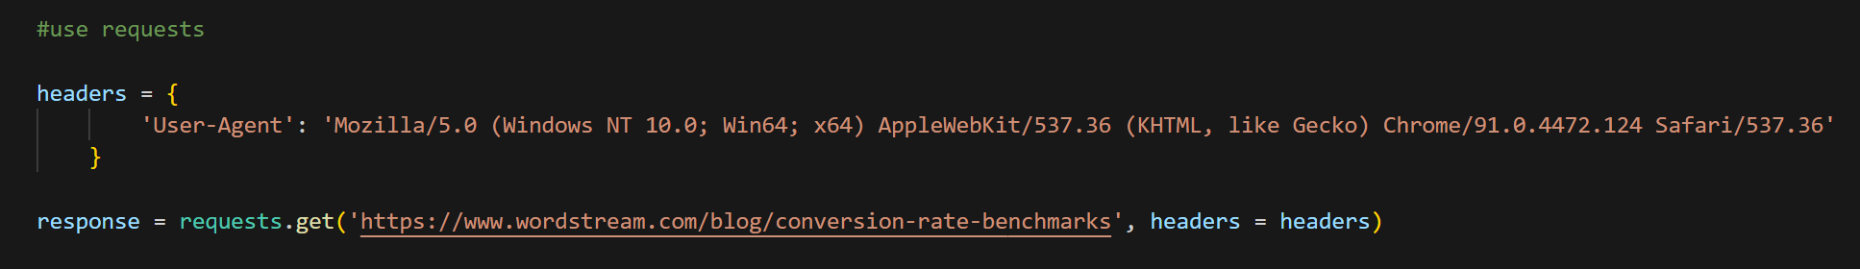
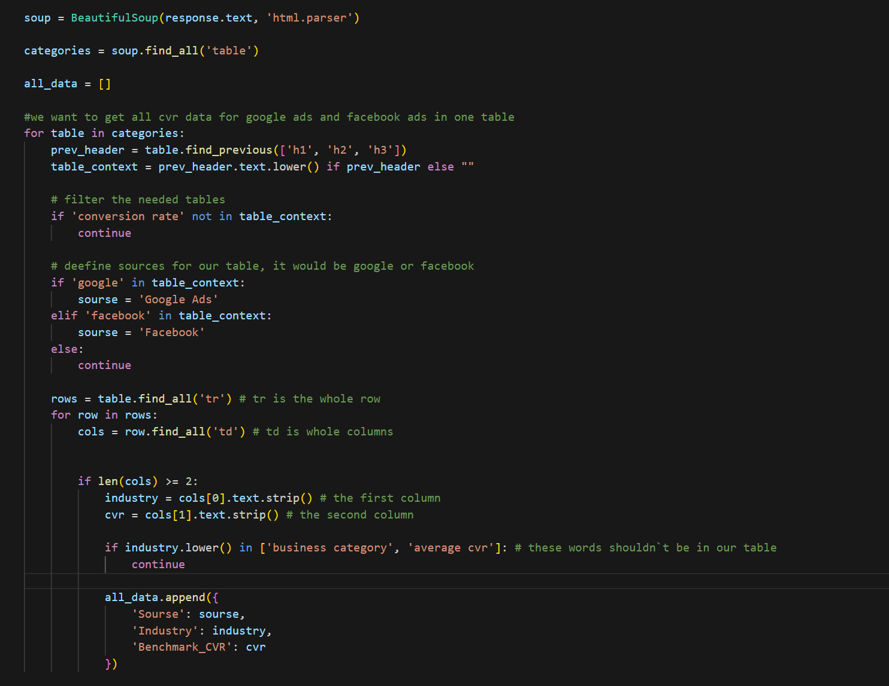
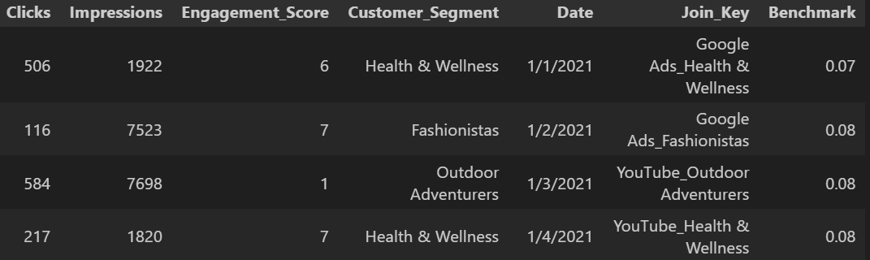
Data Acquisition & Benchmarking Methodology. Hybrid Scraping Approach.
1
Option 1: Request-Based Extraction (Direct)
Demonstrates the ability to retrieve data efficiently by
simulating HTTP requests and handling structured responses
without overhead libraries.
Option 2: HTML Parsing via BeautifulSoup:
Showcases proficiency in navigating and extracting data
from complex DOM structures, ensuring flexibility when
direct data access is restricted.
2
Data Estimation for Other Channels:
The project covers 6 marketing channels.
For channels with missing public data, benchmarks were
calculated by averaging metrics within each consumer
category, ensuring a consistent baseline for the
entire $2.50 Billion portfolio.
Outcome:
A comprehensive, verified dataset that bridges the gap
between internal performance and market standards,
ready for analysis in Excel and ML.
New data
(benchmarks)

Slide 2
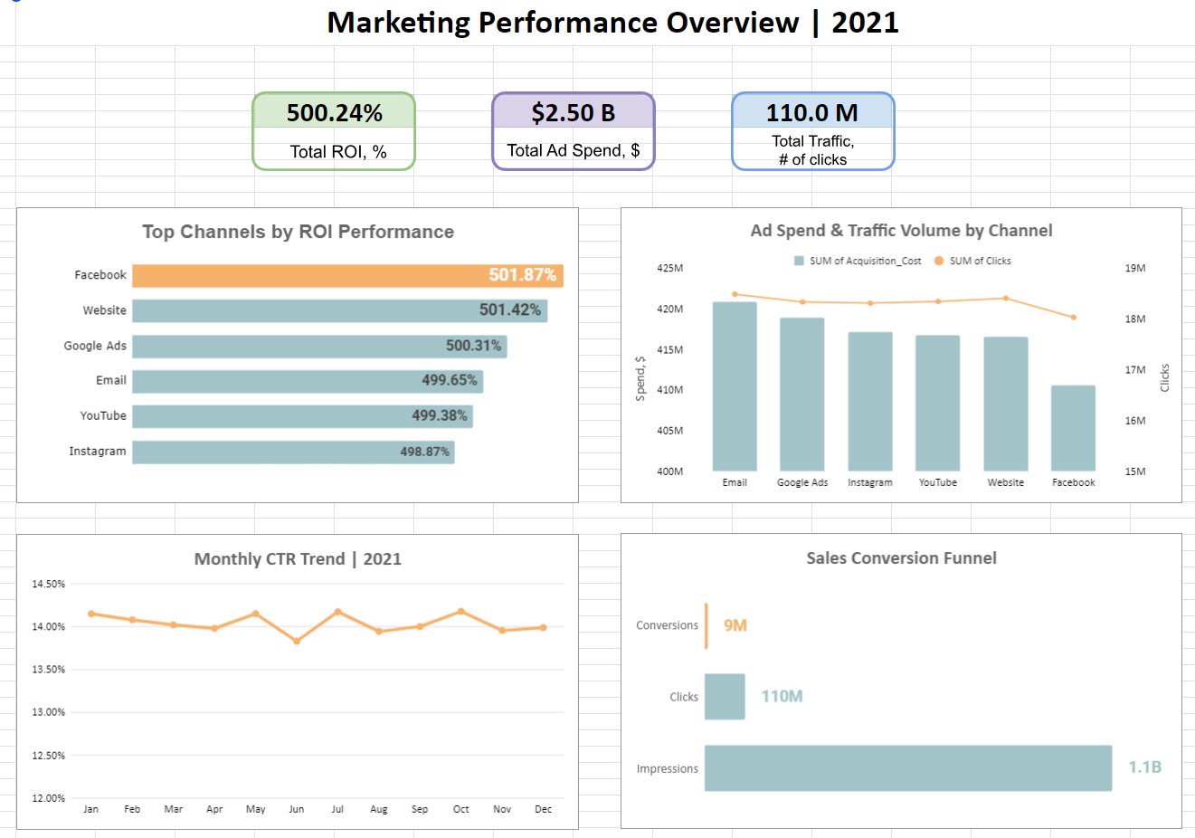
Connecting the Dots: From Granular Data to Executive Insights
The Big Picture:
Our dashboard consolidates 1.1 Billion impressions
into a single, real-time view, allowing for immediate
performance assessment across the entire
$2.50B portfolio.
Performance vs. Context:
By integrating the scraped benchmarks directly into
the visual interface, we can see that while Facebook
leads in ROI (501.87%), Google Ads remains the most
consistent over-performer relative to market standards.
Strategic Stability:
The dashboard highlights a remarkably stable CTR
of ~14%, confirming that our audience targeting
remains effective throughout the fiscal year.
Actionable Intelligence:
This unified view allows us to spot the
"Conversion Gap" in channels like Instagram and
YouTube, directing our focus toward landing page
optimization to match Facebook's efficiency.

